Slide 1

College ERP Website
Batch-4
20N31A05J3 - PATLOLLA DEEKSHA REDDY
21N35A0522 - STHALAM SAI CHARAN
20N31A05L1 - SAMMETA YASHWANTH NAIDU
Guide Name: Mr. Vijaya Raghavan

Slide 2
INTRODUCTION
College ERP Website
This project aims to solve some of those problems and thus, add more value to the current system.
A college management system built using Django framework. It is designed for interactions between students and teachers.
Features include attendance, marks and time table.
A college ERP system is a technology-based software to store, analyse, manage, and supervise the data. It also helps in smoother operations and better internal communication alongside maintaining transparency.

Slide 3
Existing System
In the existing system, the attendance once entered cann0t be altered whereas the one we proposed will allow to make changes.
It involves a lot of manual work like using spreadsheets, making reports etc..

Slide 4
Proposed system
The proposed system reduces paper work, manual work.
It also helps in maintenance of data and records made easy.
It helps in the analysis of placement of a student; it can also access the result database of the university for complete comparative result analysis.
It will reduce the time and preserves the workload and each student can able to see their report by just login profile.
In this each student’s results can be accessed from university result database. From this student performance can be analysed.
It can delete all present attendance data and create new attendance objects for the given time range.

Slide 5
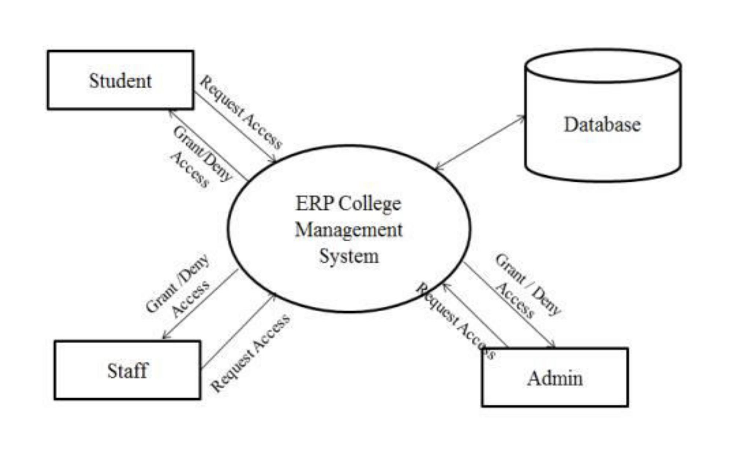
System Architecture
(How the website works)

Slide 6
Software and Hardware requirements
(Essentials)
Software Requirements
Web Server
Web Scripting Language - HTML
Operating system - Windows 2000/XP/2003/vista/7/8
Hardware Requirements
Processor - Intel Core i5 or equivalent
Memory - 2GB (32-bit), 4GB (64-bit)
Disk space - 1.5GB of free disk space
Screen resolution - 1024x768 pixels

Slide 7
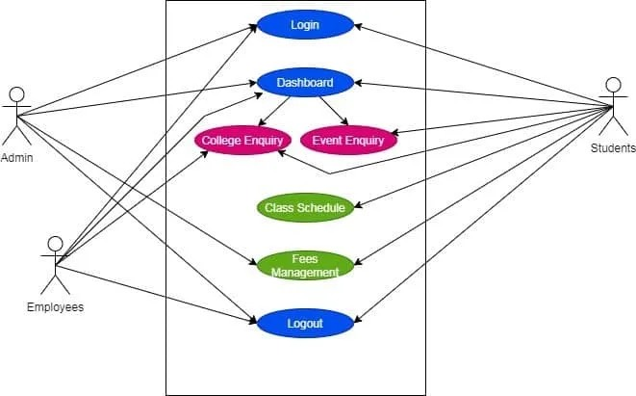
UML diagrams
Use case Diagram:
Fig : graphical depiction of a user's possible
interactions with a system.

Slide 8
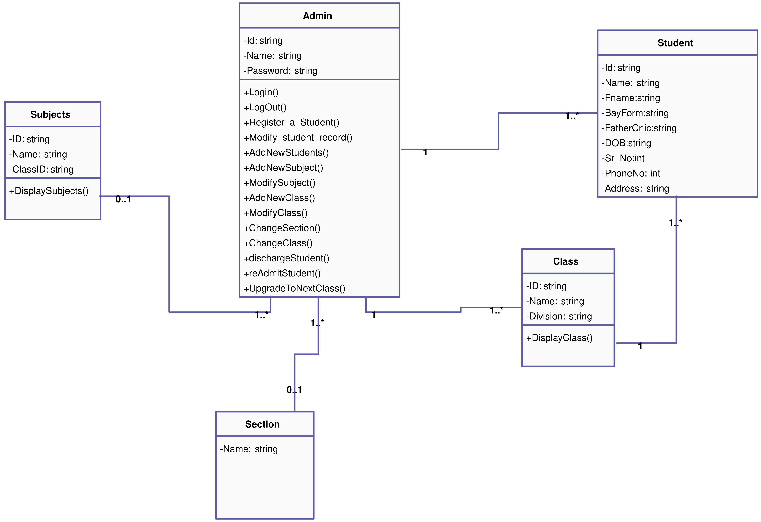
Class Diagram:
Fig : Describes the attributes and operations of a
class and also the constraints imposed on the system.

Slide 9
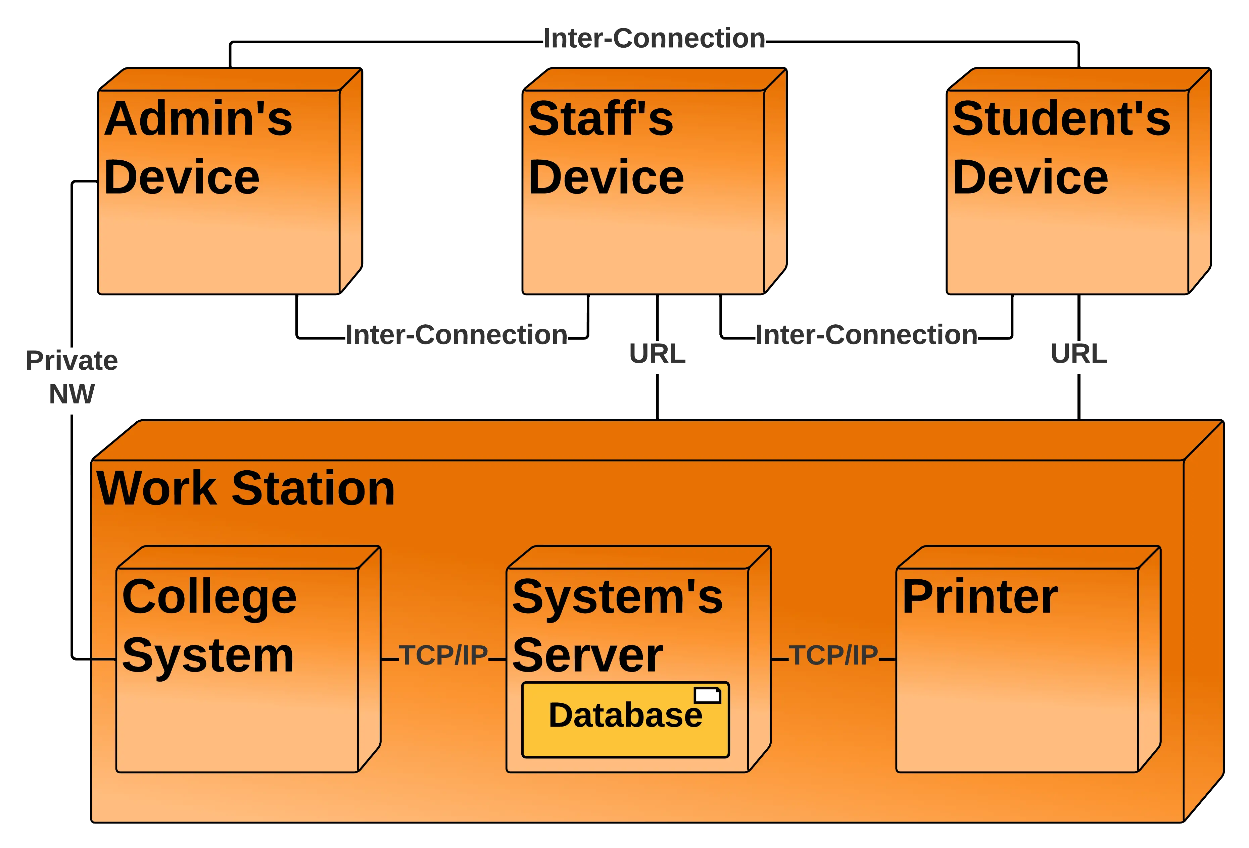
Deployment Diagram:
Fig: shows the physical architecture applied for the system to work.

Slide 10
Thank you!

